Slide 1
Chapter 9
Citizenship and the Constitution

Slide 2
Section 1-Understanding the Constitution
The United States is a representative democracy-a government led by officials who are chosen by the people.
The Constitution created a federal system in which power is divided between the states and the federal government.
The powers that are granted to the federal government are called delegated powers.
Examples:
coining money
regulating interstate and international trade
defense
declares war
conducts diplomacy

Slide 3
Federalism
Sometimes, Congress has stretched its delegated powers to address unexpected issues.
Article 1, Section 8 says that Congress is allowed to, “make all laws which shall be necessary and proper” for it to carry out its duties.
Because of its flexibility for the government, this clause has become to be called the elastic clause.

Slide 4
Reserved Powers
The Powers that are kept by the state governments or by citizens are called reserved powers.
These powers include:
Creating local governments
Holding elections
Education
Trade within their borders

Slide 5
Concurrent Powers
Powers that are shared by both the federal and state government are called concurrent powers.
These include:
Taxing citizens
Borrowing money
Enforcing laws
Providing for citizens’ welfare

Slide 6
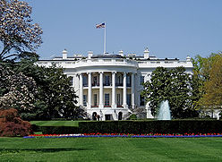
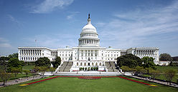
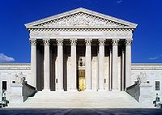
Separation of Powers
The Federal Government is divided into three separate powers, each with its own responsibilities:
The Legislative Branch (The House of Representatives and the Senate)
The Executive Branch
The Judicial Branch

Slide 7
The Legislative Branch
This Branch makes the nations laws.
It is broken up into two houses
The House of Representatives (435 members)
The Senate (100 members)
The census every 10 years determines the number of representatives each state gets.
Apportionment or planned distribution of representatives is also used. To keep the number current, no state is allowed to gain a representative unless another state looses one.

Slide 8
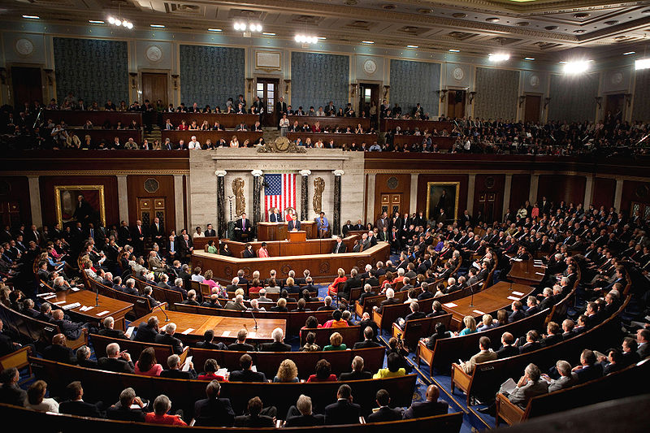
The House of Representatives
Members must be at least 25 years old
Must be a U.S. citizen for 7 or more years
Must be residents of the state in which they represent
Serve 2 year terms
No term limit to
this office

Slide 9
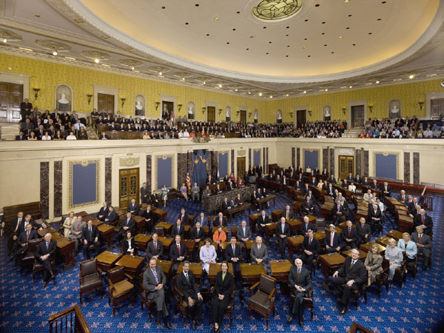
The Senate
Made up of 2 Senators from each state.
Must be at least 30 years old
Must be a U.S. citizen for at least 9 years
Serve 6 year terms
Must be residents of the state they represent
There is no term limit to this office

Slide 10
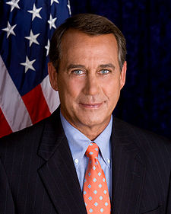
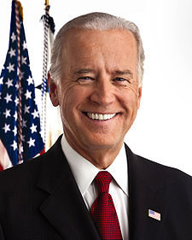
Facts about Congress
The political party that has the most members is called the majority
The party with the fewest members is called the minority
The Leader of the House is called the Speaker of the House. They are selected by their own party.
The Vice President is the president of the Senate. He does not join the Senate in debate, but he is the tie break in case of a tie.
Congress begins it new session each year the first week of January.

Slide 11
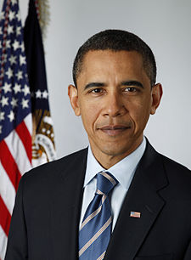
The Executive Branch
This Branch enforces the laws that are passed by Congress.
The President of the United States is the head of this Branch. He is the most powerful elected official in the country.
He must be:
Native born to the United States
At least 35 years old
A U.S. resident for at least 14 years.
These rules are the same for Vice-President

Slide 12
Facts about the Executive Branch
The President serves 4 year terms
The 22nd Amendment limited his office to two terms.
One exception was F.D.R. He won four terms due to depression and war.
If the President dies or is impeached, the Vice-President becomes President.
The term impeach means to bring charges of “treason, bribery, or other high crimes and misdemeanors” against a President.
Two Presidents have been impeached:
Andrew Johnson in 1868 and Bill Clinton in 1998. President Nixon resigned in 1974 to avoid impeachment.

Slide 13
Working with Congress
The system of checks and balances forces the Executive and Legislative Branches to work together.
The President has the power to approve or reject a bill. The veto is used when the President wants to reject a bill.
Congress can override a veto with a 2/3rds majority vote.
The President can also use an executive order, a command that has the power of law, in case of an emergency.
The President also has the power to issue a pardon, or freedom from punishment for those people who have been convicted of federal crimes or are facing charges.
The President is supported and advised by his cabinet, important department heads that the President chooses to oversee important matters.

Slide 14
The Judicial Branch
This Branch is made up of a system of federal courts headed by the U.S. Supreme Court.
A federal court can strike down a state or another federal law if the court finds the law unconstitutional.
Federal judges are appointed by the President.
They serve for life.
Each state has at least one federal court to oversee federal cases in the state. States with larger populations have more than one district court.
Today there are 94 U.S. district courts and 13 courts of appeals that review lower-court decisions.

Slide 15
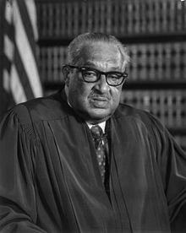
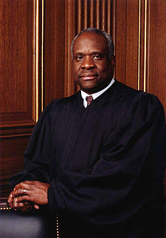
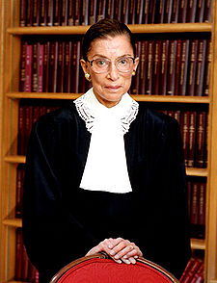
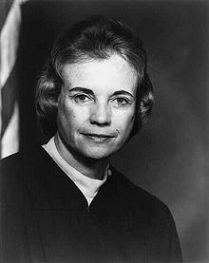
The Supreme Court
Hear about 100 cases a year chosen by the Justices themselves.
There has traditionally been nine Justices on the Court. Congress chooses how many Justices will sit at any time.
In 1967, Thurgood Marshall became the first African-American to serve on the Court, with Clarence Thomas becoming the second in 1991.
Right now there are 2 women sitting on the Court, Ruth Bader Ginsburg and Sandra Day O’Connor. O’Connor became the first female on the Court in 1981. She was selected by President Ronald Reagan.

Slide 16
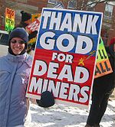
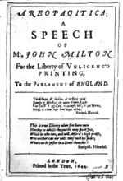
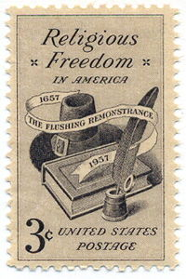
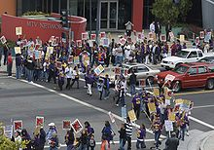
Section 2-The Bill of Rights
President James Madison promised a Bill of Rights would be added to the Constitution.
The Rights were considered basic rights to all Americans.
The First Amendment provides freedom of:
Religion-the government cannot support of interfere with the practice of religion
The press-the government provides citizens to express their points of view and to hear other ideas from others.
Speech-This does not however mean that people can say whatever they want. They cannot say something that might endanger the life of another person.
Assembly-any group may meet to discuss issues or conduct business as long as the activity is not illegal.
Petition-make a request of the government to show their dissatisfaction with their government.

Slide 17
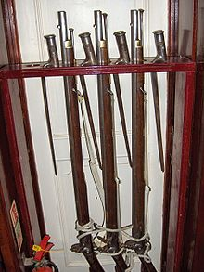
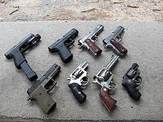
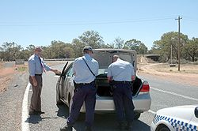
Protecting Citizens
The Second, Third, and Fourth Amendments all relate to colonial disputes.
The Second Amendment deals with state militias, now replaced by the National Guard, and the right to keep and bear arms.
The Third Amendment keeps the military from forcing citizens to give housing to soldiers.
The Fourth Amendment protects citizens against illegal searches and seizures. It requires authorities to obtain a search warrant, an order permitting them to look through someone’s property.

Slide 18
The Rights of the Accused
The Fifth, Sixth, Seventh, and Eighth Amendments provides guidelines for trying people accused of crimes.
The Fifth Amendment provides due process of law. Due process means that the law should always be fairly applied.
It also gives a grand jury a chance to see if there is enough evidence to try someone of a crime. If there is enough evidence found, then they indict, or formally accuse, the individually of the crime.
It also protects people from being forced to testify against themselves. If they are found not guilty, the Fifth amendment keeps them from being tried again for the same crime. This clause is called double jeopardy.
The final clause states that no one will have property taken away “without due process of law”. One exception is eminent domain. This is the power of the government to take personal property to benefit the public.

Slide 19
The Sixth Amendment
This Amendment protects the rights of those accused of crimes.
It assures them a quick public trial by jury.
The accused has the right to know the crimes being brought before them.
They have the right to hear questions and answers against them.
They have the right to an attorney and if they cannot afford one, the government provides one for them.

Slide 20
The Seventh Amendment
The Seventh Amendment states that juries can decide on civil cases. These are cases in which a person causes physical or financial harm to another person without committing a crime.
In such cases, the injured party may sue, or seek justice, in civil court.
Civil cases usually involve disputes over money or property.

Slide 21
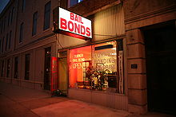
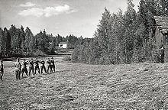
The Eight Amendment
The Eight Amendment allows for defendants to post bail. Bail is money that defendants promise to pay the court if they do not appear in court at the proper time.
This ensures that the defendant does not have to sit in jail until his trial takes place.
If he/she does not show up, then the court demands the bail money and issues a warrant for their arrest.
The Eight Amendment also prevents the courts from setting excessive bail. However, the judge can refuse bail altogether if the defendant has committed a violent crime.
Cruel and unusual punishment is also banned by the Eighth Amendment. The death penalty in some states had to be changed because they were deemed cruel and unusual.

Slide 22
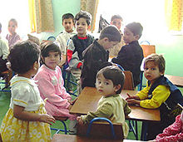
The Rights of States and Citizens
The last two amendments provide general protections for individual rights that are not addressed by the first 8. They also reserve some governmental powers for the states and the people.
The Ninth Amendment states that the rights stated in the Bill of Rights are not the only rights citizens have.
Example: Education

Slide 23
The Tenth Amendment
The Tenth Amendment recognizes that the states and the people have additional powers beyond those specifically mentioned in the Constitution.
These include any powers that the Constitution does not specifically grant to Congress or deny to the states.
It basically protects citizens’ rights and keeps a balance of power between the state and federal government.
Example: Roe vs. Wade

Slide 24
Section 3-Rights and Responsibilities of Citizenship
“Freedom is never more than one generation away from extinction. We didn't pass it to our children in the bloodstream. It must be fought for, protected, and handed on for them to do the same, or one day we will spend our sunset years telling our children and our children's children what it was once like in the United States where men were free.”
Ronald Reagan

Slide 25
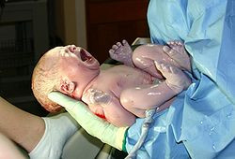
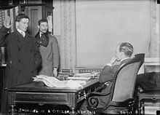
Becoming a U.S. citizen
People can become a citizen of the United States in several ways:
Anyone born in a U.S. state or territory is a citizen (14th Amendment)
Naturalization-the process by which a foreign born person is granted full U.S. citizenship. The process teaches them what it means to be an American.
Legal permanent immigrants have full rights of American citizens except for holding office and voting.
Illegal immigrants are deported, sent back to their county of origin, if they are here through breaking the law.

Slide 26
Duties of Citizens
In addition to having certain rights, citizens also have responsibilities. "The stakes . . . are too high for government to be a spectator sport." - Congresswoman Barbara Jordan
Citizens elect leaders to make laws for them. In turn citizens must obey these laws.
Citizens also have an obligation to respect those in authority such as parents, police officers, and teachers.
Citizens also have a responsibility to pay taxes. These taxes go to pay for schools, public roads, and emergency personal such as firemen and police.

Slide 27
Forms of taxation
Individual Income Tax-Taxes people pay on their total personal income.
Corporate Income Tax-Taxes that businesses pay on the money they earn.
Payroll Tax-Taxes on the money a worker makes. Usually the tax is automatically deducted from their paychecks. People who are self employed have to carry the whole tax burden, whereas workers and businesses share the tax burden.
Consumption Tax-Taxes places on the sale of goods and services. These include a general sales tax (TN is 9.75%) on all goods and services, and some goods have an excise tax. This is a tax on specific kinds of items, such as tobacco, alcohol, gasoline, and luxury items.
Property Taxes-Taxes on buildings and land owned by individuals and companies. These are local and state only.
Estate, inheritance, and gift taxes-Taxes on money or property that is transferred from one individual to another. Estate taxes are placed on an estate of a person who has died. Inheritance taxes are paid by the family members who receive a dead person’s estate. A gift tax is paid on a transfer of assets between living people.

Slide 28
How Taxation Works
Governments impose taxes as a primary means of gaining revenue.
The concept is that all people pay a fair share toward needed programs and services.
Individual income taxation is the largest method of revenue in the U.S. It funds Social Security, Medicare, and Medicaid.
Taxation is based on the amount of income you receive. The more you make, the more you pay.
Every April 15th is income tax day. By that day all Americans must pay a certain percentage of their income to the federal government.
http://en.wikipedia.org/wiki/Tax_bracket

Slide 29
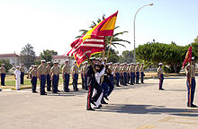
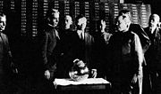
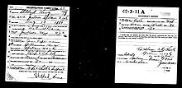
Duties of Citizens continued…
Citizens also have a duty to protect and defend the nation from harm. If a war breaks out, citizens should try to help in the war effort.
In some situations the federal government has set up a draft, or required military service.
Since 1973 though, the U.S. has had a volunteer only military. However, young men must register for the draft when they turn 18.
Citizens also can be called to serve on a jury.

Slide 30
Citizens and Elections
Elections form the basis of a representative democracy in the U.S.
Citizens should learn about this process and be involved through voting, campaigning, or by giving money to candidates through political action committees; AKA lobby groups. PAG’s are groups that collect money to give to candidates who support certain issues.
Voters must be 18 years old to vote.

Slide 31
Community Service
Civic virtue is a force that has made Americans feel good about helping others.
Certain groups have been good examples of community service:
The American Red Cross
Habitat for Humanity
Boys and Girls Scouts

